Slide 1
CSE322
DFA and NDFA
Lecture #3

Slide 2
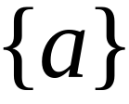


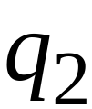


Nondeterministic Finite Automaton
Alphabet =

Slide 3
Alphabet =
Two choices

Slide 4
Alphabet =
Two choices
No transition
No transition

Slide 5
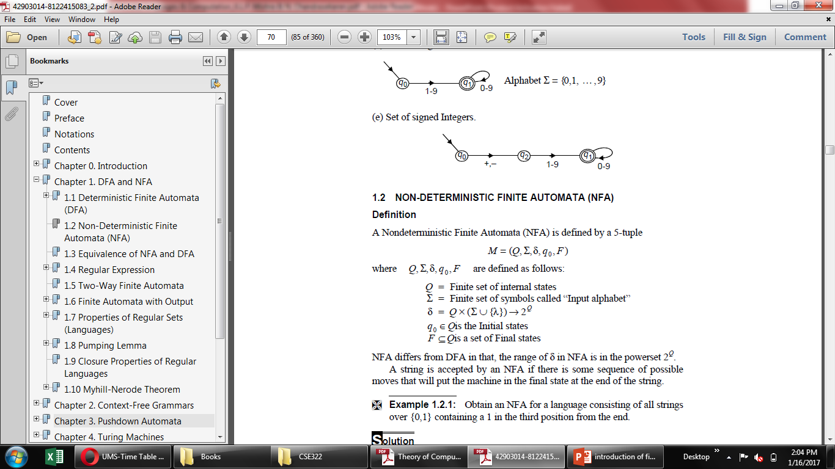
NFA and DFA

Slide 6
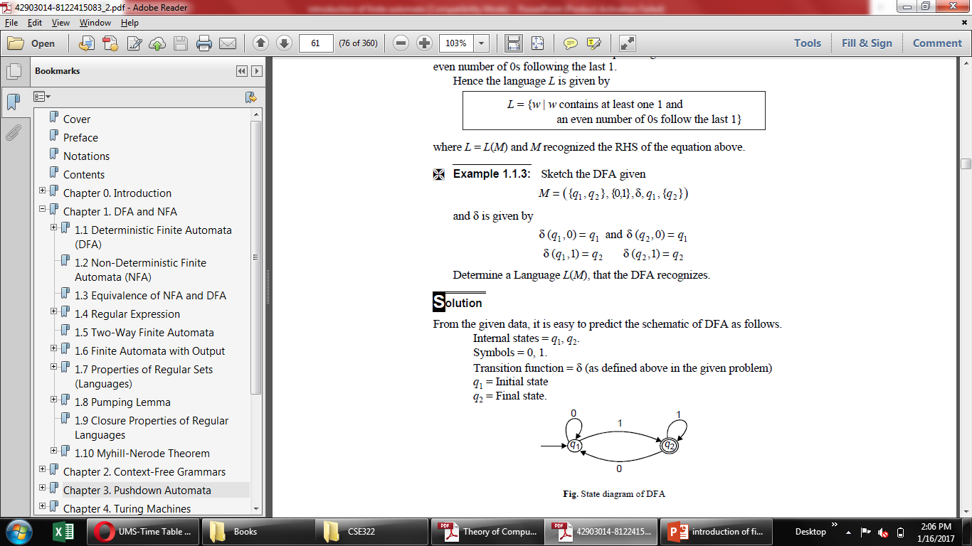

Slide 7
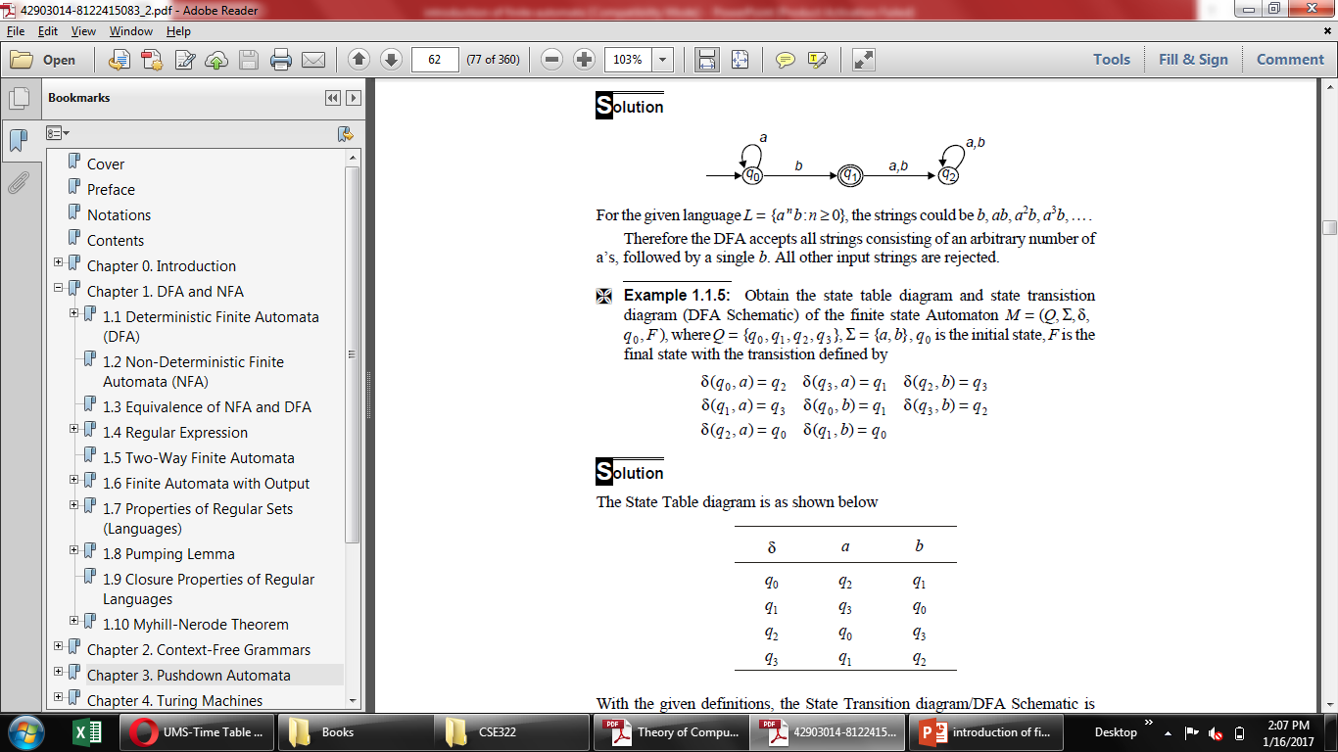

Slide 8

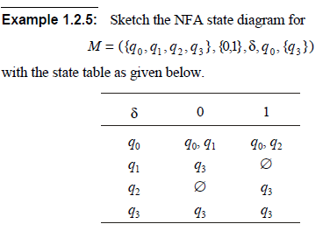

Slide 9
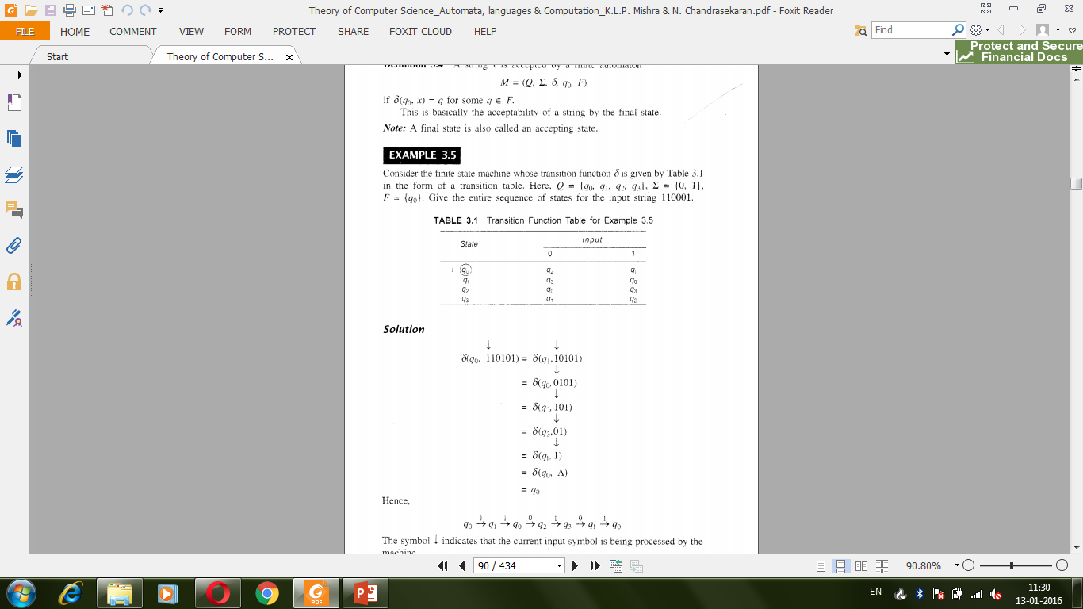

Slide 11
Real Life examples
example can be any person's career. a person can learn hours and study various subjects but will still land on a career less predictable like a mathematics student may become a soldier, a botanist may become cook etc.
Downloading a movie

Slide 12
CSE322
Equivalence of DFA and NDFA
Lecture #3

Slide 13
Acceptablity
NFAs and DFAs are equivalent in that if a language is recognized by an NFA, it is also recognized by a DFA and vice versa

Slide 14
DFA and NDFA
Every NDFA is DFA but vice versa is not true

Slide 15
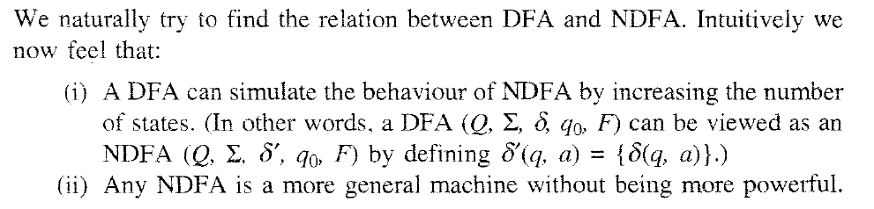
Equivalence of DFA and NDFA
Notes:
Equivalence of DFA and NDFA

Slide 16
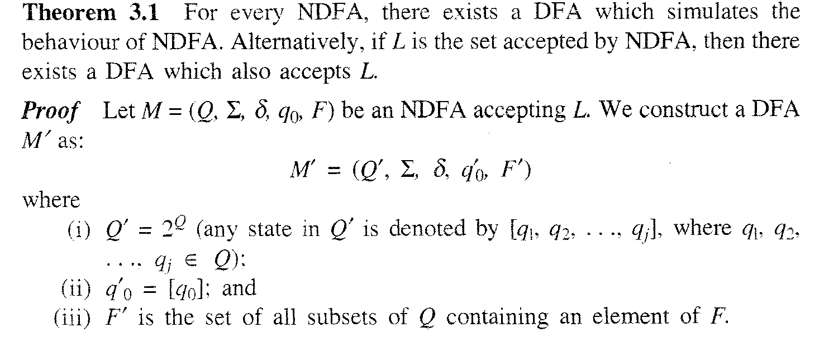
Equivalence of NFA and DFA

Slide 17
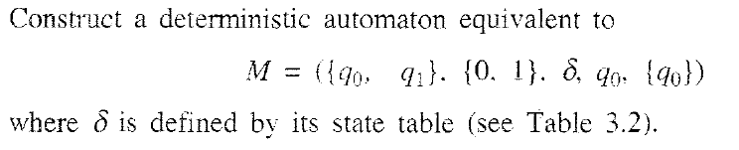
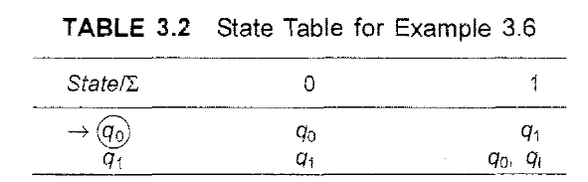
Problem
Notes:
Problem

Slide 18
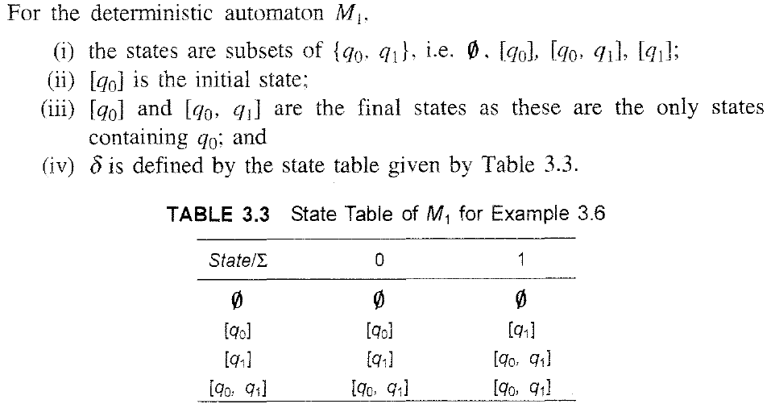
Solution

Slide 19
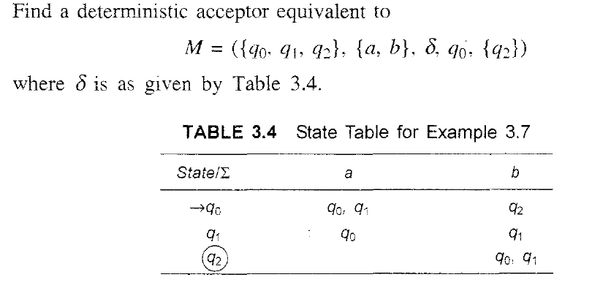
Problem
Notes:
Problem

Slide 20
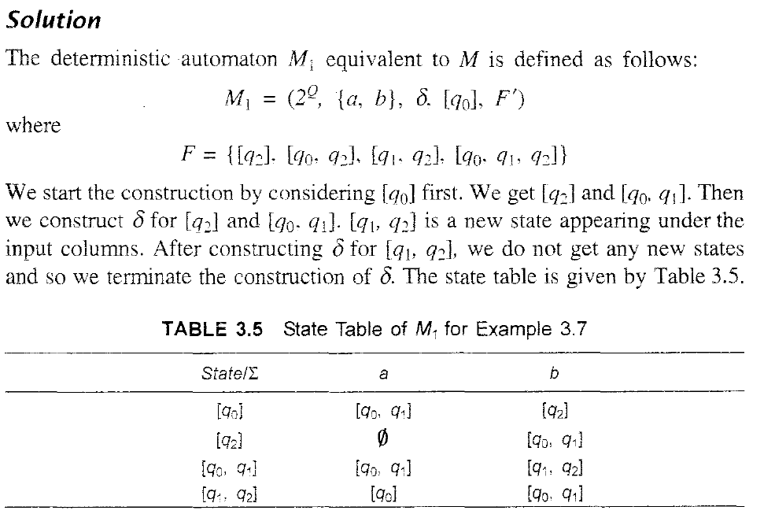
Solution

Slide 21
